Slide 1
TCP
Part II

Slide 2
Connection Management in TCP
Opening a TCP Connection
Closing a TCP Connection
Special Scenarios
State Diagram

Slide 3
TCP Connection Establishment
TCP uses a three-way handshake to open a connection:
(1) ACTIVE OPEN: Client sends a segment with
      SYN bit set *
      port number of client
      initial sequence number (ISN) of client
(2) PASSIVE OPEN: Server responds with a segment with
      SYN bit set *
      initial sequence number of server
      ACK for ISN of client
  (3) Client acknowledges by sending a segment with:
      ACK ISN of server (* counts as one byte)

Slide 4
TCP “Three-Way Handshake” Connection Establishment Procedure
Client |  |  | Server
Start State | Action | Move To State | Start State | Action | Move To State
CLOSED | The client cannot do anything until the server has performed a passive OPEN and is ready to accept a connection. (Well, it can try, but nothing will be accomplished until the server is ready.) | — | CLOSED | The server performs a passive OPEN, creating a transmission control block (TCB) for the connection and readying itself for the receipt of a connection request (SYN) from a client. | LISTEN
CLOSED | Step #1 Transmit: The client performs an active OPEN, creating a transmission control block (TCB) for the connection and sending a SYN message to the server. | SYN-SENT | LISTEN | The server waits for contact from a client. | —
SYN-SENT | The client waits to receive an ACK to the SYN it has sent, as well as the server's SYN. | — | LISTEN | Step #1 Receive, Step #2 Transmit: The server receives the SYN from the client. It sends a single SYN+ACK message back to the client that contains an ACK for the client's SYN, and the server's own SYN. | SYN-RECEIVED

Slide 5
Start State | Action | Move To State | Start State | Action | Move To State
SYN-SENT | Step #2 Receive, Step #3 Transmit: The client receives from the server the SYN+ACK containing the ACK to the client's SYN, and the SYN from the server. It sends the server an ACK for the server's SYN. The client is now done with the connection establishment. | ESTABLISHED | SYN-RECEIVED | The server waits for an ACK to the SYN it sent previously. | —
ESTABLISHED | The client is waiting for the server to finish connection establishment so they can operate normally. |  | SYN-RECEIVED | Step #3 Receive: The server receives the ACK to its SYN and is now done with connection establishment. | ESTABLISHED
ESTABLISHED | The client is ready for normal data transfer operations. |  | ESTABLISHED | The server is ready for normal data transfer operations.

Slide 6
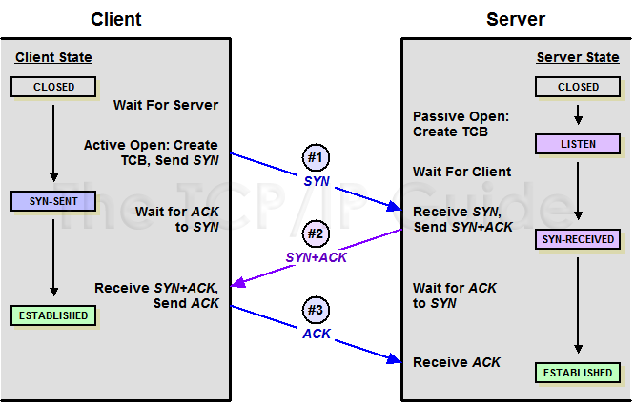
TCP “Three-Way Handshake” Connection Establishment Procedure

Slide 7
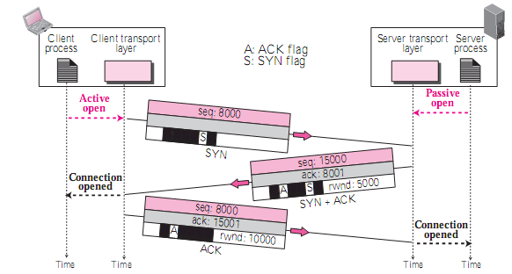
TCP Connection establishment
Three-Way Handshaking: Example
it is ready to accept a connection,
Cannot initiate

Slide 8
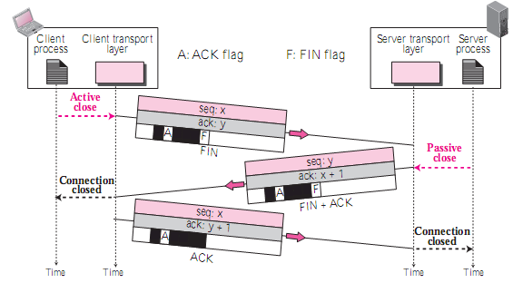
TCP Connection Termination
Three-Way Handshaking

Slide 9
4 Way Handshaking
Half-Close (4-way handshaking): one end can stop sending data while still receiving data.
  E.g. sorting at server (client sends data and waits)
  Server requires all data before starting sorting
See the following figure:

Slide 10
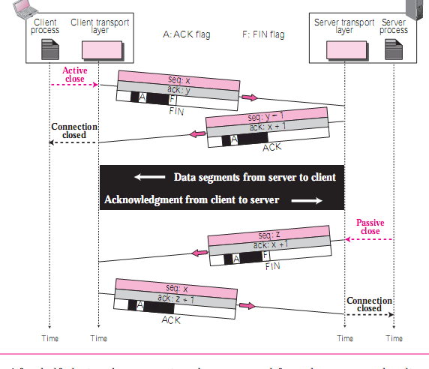

ACK consumes no new seq no.

Slide 11
2MSL Wait State
2MSL Wait State = TIME_WAIT
When TCP does an active close, and sends the final ACK, the connection must stay in in the TIME_WAIT state for twice the maximum segment lifetime.
2MSL= 2 * Maximum Segment Lifetime
Why?
TCP is given a chance to resend the final ACK. (Server will timeout after sending the FIN segment and resend the FIN)
The MSL is set to 2 minutes or 1 minute or 30 seconds.

Slide 12
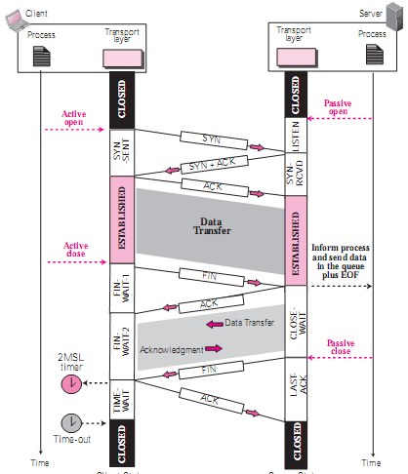

Slide 13
Resetting Connections
Resetting connections is done by setting the RST flag
When is the RST flag set?
  Connection request arrives and no server process is waiting on the destination port
  Abort (Terminate) a connection
  Causes the receiver to throw away buffered data. Receiver does not acknowledge the RST segment

Slide 14
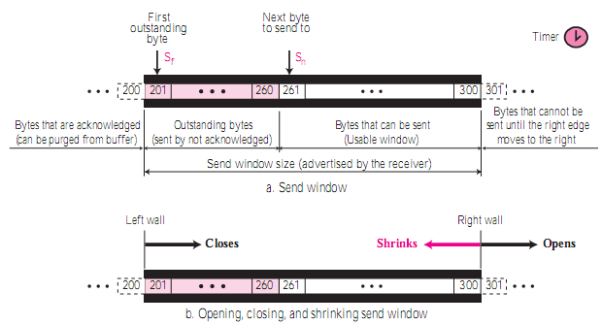
TCP send window

Slide 15
Note
The window in SR numbers packets, but the window in the TCP numbers bytes.
The variables that control the window are expressed in bytes.

Slide 16
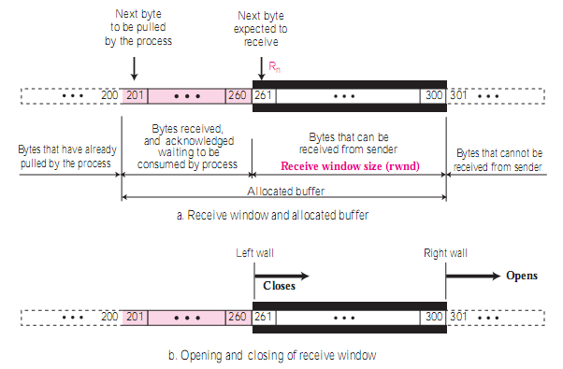
TCP receive window

Slide 17
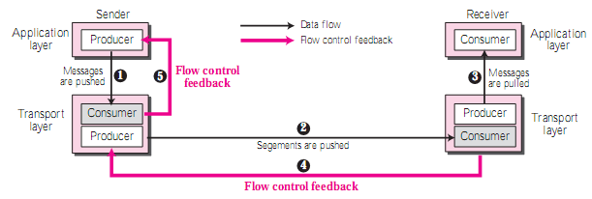
TCP Flow Control

Slide 18
Closing and opening of window
Window closes
  (moves its left wall to the right)
Window opens
  (moves its right wall to the right)

Slide 19
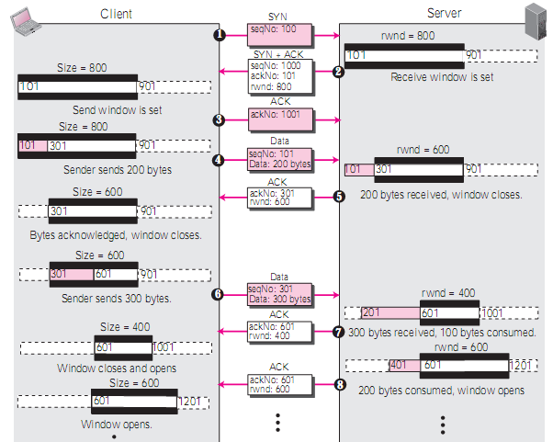

Slide 20
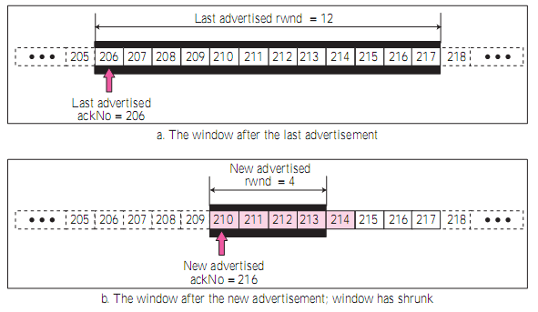
Shrinking of Windows
Receive window cannot shrink.
Send window can shrink if the receiver deﬁnes a specific value for rwnd.

Slide 21
Trade-off in Optimal Size of TCP Segments
If segments are too large, They are fragmented at the IP level
Too small segments greatly reduce performance because we are sending a small amount of data in a segment with at least 40 bytes(20 Bytes TCP’s +20 Bytes IP’s) header overhead
  We also use up valuable processing time that is required to handle each of these small segments
The MSS(Maximum Segment Size) parameter ensures that we don't send segments that are too large
  TCP is not allowed to create a segment larger than the MSS.
Unfortunately, the basic sliding windows mechanism doesn't provide any minimum size of segment that can be transmitted

Slide 22
Silly Window Syndrome
Lets assume the MSS is 360 and a client/server pair where the server's initial receive window is set to the same value, 360
  This means the client can send a “full-sized” segment to the server
As long as the server can keep removing the data from the buffer as fast as the client sends it, we should have no problem
  In reality the buffer size would normally be larger than the MSS
Now, imagine that the server is bogged down for whatever reason while the client needs to send it a great deal of data
  Let's say that the server is only able to remove 1 byte of data from the buffer for every 3 bytes it receives.
  Let's say it also removes 40 additional bytes from the buffer during the time it takes for the next client's segment to arrive.
Here's what will happen:

Slide 23
Example: Silly Window Syndrome
The client's send window is 360, and it has lots of data to send. It immediately sends a 360 byte segment to the server
  This uses up its entire send window
When the server gets this segment, it acknowledges it. However, it can only remove 120 bytes so the server reduces the window size from 360 to 120
  It sends this in the Window field of the acknowledgment.
The client receives an acknowledgment of 360 bytes, and sees that the window size has been reduced to 120
  It wants to send its data as soon as possible, so it sends off a 120 byte segment.
The server has removed 40 more bytes from the buffer by the time the 120 byte segment arrives
  The buffer thus contains 200 bytes (240 from the first segment, less the 40 removed)

Slide 24
Example: Silly Window Syndrome
The server is able to immediately process one-third of those 120 bytes, or 40 bytes.
  This means 80 bytes are added to the 200 that already remain in the buffer.
The server must reduce the window size to 80 bytes.
  The client will see this reduced window size and send an 80 byte segment.
The server started with 280 bytes and removed 40 to yield 240 bytes left.
It receives 80 bytes from the client, removes one third, so 53 are added to the buffer, which becomes 293 bytes.
  It reduces the window size to 67 bytes (360-293).
This process will continue for many rounds, with the window size getting smaller and smaller, especially if the server gets even more overloaded.
Its rate of clearing the buffer may decrease even more, and the window may close entirely.

Slide 25
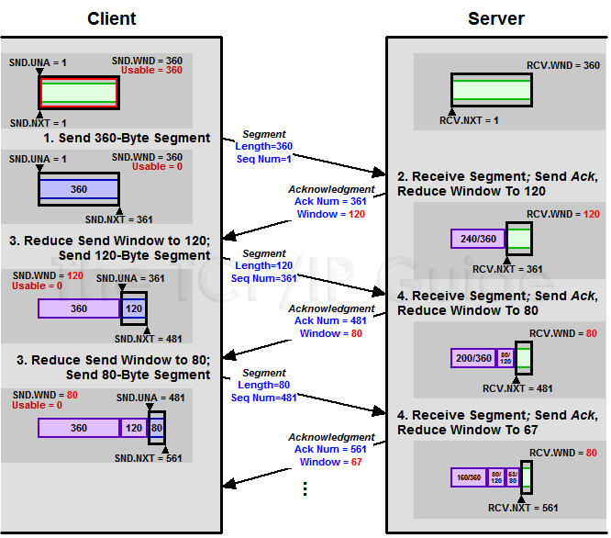

Slide 26
Silly Syndrome Created by the Sender
The solution is to:
  prevent the sending TCP from sending the data byte by byte. Wait to collect larger data.
But, How long?
  If it waits too long, it may delay the process.
  If it does not wait long enough, it may end up sending small segments.

Slide 27
The "small packet problem“
When an application repeatedly emits data in small chunks, frequently only 1 byte in size.
Since TCP packets have a 40 byte header (20 bytes for TCP, 20 bytes for IPv4), this results in a 41 byte packet for 1 byte of useful information, a huge overhead.
  This situation often occurs in Telnet sessions, where most key presses generate a single byte of data that is transmitted immediately.
Worse, over slow links, many such packets can be in transit at the same time, potentially leading to congestion.

Slide 28
The Solution: Nagle’s Algorithm
Sender-side handling of silly window syndrome
A means of improving the efficiency of TCP/IP networks by reducing the number of packets that need to be sent over the network
Nagle's algorithm works by combining a number of small outgoing messages, and sending them all at once
As long as there is a sent packet for which the sender has received no acknowledgment, the sender should keep buffering its output until it has a full packet's worth of output, so that output can be sent all at once.

Slide 29
Nagle’s Algorithm
The sending TCP sends the ﬁrst piece of data it receives from the sending application even if it is only 1 byte.
The sending TCP accumulates data in the output buffer and waits until an ack received or a maximum-size segment is formed.
Step 2 is repeated for the rest of the transmission
if there is new data to send
if the window size >= MSS and available data is >= MSS
send complete MSS segment now
else
if there is unconfirmed data still in the pipe
enqueue data in the buffer until an acknowledge is received
else send data immediately
end if
end if
end if

Slide 30
Silly Syndrome Created by the receiver
When
Receiver application consumes data slowly
Buffer is full, window size announced as 0
Byte-by-byte is received by application

Slide 31
The Solution: Clark’s Algorithm
Receiver-side handling of silly window syndrome
If the receiver's announced window drops to zero, avoid reopening it to small values
Instead, wait until a window size of one MSS or half the receiver’s buffer size can be announced (whichever is smaller)

Slide 32
Error Control

Slide 33
Error Control
Checksum
Acknowledgements
  Cumulative Acknowledgment (ACK)
Acknowledging receipt of segments cumulatively. The receiver advertises the next byte it expects to receive, ignoring all segments received and stored out of order.
  Selective Acknowledgment (SACK)
Does not replace ACK, but reports additional information to the sender. A SACK reports a block of data that is out of order, and also a block of segments that is duplicated, i.e. received more than once.
There is no provision in the TCP header for adding this type of information; Thus, SACK is implemented as an option at the end of the TCP header.
Time-out

Slide 34
Rules for Generating Acknowledgments
Piggyback ACKs, if possible
Delay the sending of ACK (until another segment arrives or until a period of time(500ms) has passed) if there is only 1 outstanding in-order segment received.
There should not be more than two in-order unacknowledged segments at any time.
When an out-of-order segment arrives with sequence number higher than expected, the receiver immediately sends an ACK for the expected segment

Slide 35
Rules…Contd.
When a missing segment arrives, the receiver sends an ACK segment to announce the next sequence number expected.
If a duplicate segment arrives, the receiver discards the segment, but immediately sends an acknowledgment indicating the next in-order segment expected

Slide 36
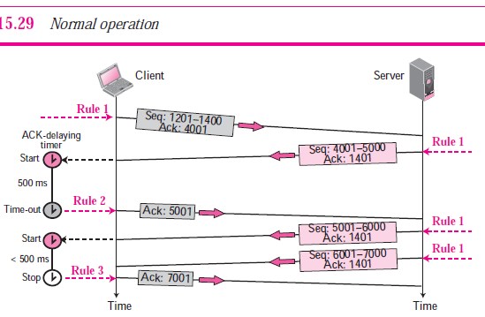

Slide 37
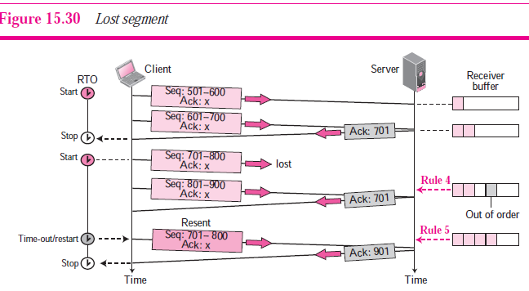

Slide 38
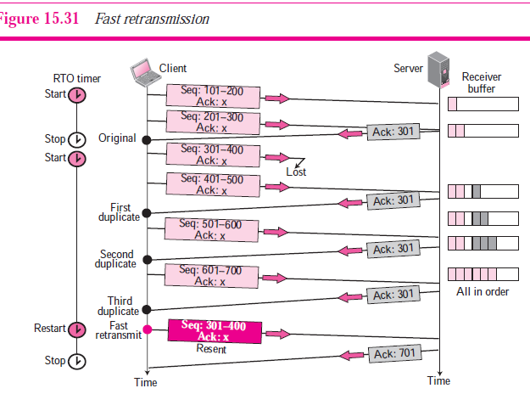
if three duplicate acknowledgments (i.e., an original ACK plus three exactly identical
copies) arrives for a segment, the next segment is retransmitted without waiting for the time-out.

Slide 39
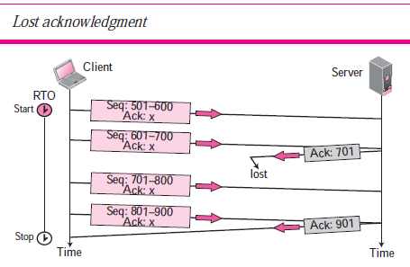

Slide 40
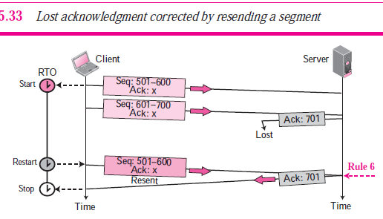

Slide 41
Congestion

Slide 42
Congestion: Causes
When the load on the network (# of packets sent to the network) is greater than the capacity of the network (# of packets a network can handle)
The routers are too slow to perform bookkeeping tasks (e.g., queuing buffers)
The routers' buffer is too limited
Slow speed CPU at routers

Slide 43
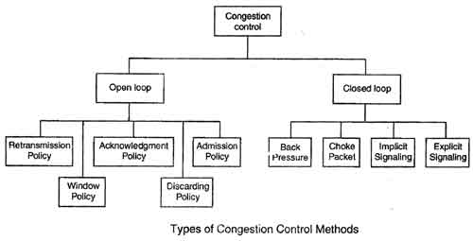
Congestion Control

Slide 44
Open Loop congestion control
Policies are applied to prevent congestion before it happens.
Handled by either the source or the destination.

Slide 45
Congestion Control Policies
Retransmission Policy
  retransmission policy and
  retransmission timers
Window Policy
Acknowledgment Policy

Slide 46
Retransmission Policy
Retransmission is sometimes unavoidable
  when the sender feels that a sent packet is lost or corrupted
Retransmission in general may increase congestion in the network
However, a good retransmission policy can prevent congestion
The retransmission policy and the retransmission timers must be designed to optimize efficiency and at the same time prevent congestion
  Viz., the retransmission policy used by TCP is designed to prevent or alleviate congestion

Slide 47
Window Policy
The type of window at the sender may also affect congestion
  The Selective Repeat window is better than the Go-Back-N window for congestion control

Slide 48
Acknowledgment Policy
Imposed by the receiver
If the receiver does not acknowledge every packet it receives, it may slow down the sender and help prevent congestion
Several approaches are used in this case:
  A receiver may send an acknowledgment only if it has a packet to be sent or a special timer expires.
  A receiver may decide to acknowledge only N packets at a time.
We need to know that the acknowledgments are also part of the load in a network.
  Sending fewer acknowl­edgments means imposing less load on the network.

Slide 49
Closed-Loop Congestion Control
To alleviate congestion after it happens
Various Methods used are:
  Backpressure
  Choke Packet
  Implicit Signalling
  Explicit Signalling

Slide 50
TCP Congestion Control
TCP uses a congestion window
and a congestion policy

Slide 51
Congestion Window
We already know that:
  Sender window size is determined by the available buffer space in the receiver (rwnd)
But, What if network fails to deliver with the rate data is created at sender?
It must tell the sender to slow down
  Thus, in addition to the receiver, the network is a second entity that determines the size of the sender’s window
Sender has two pieces of information: the receiver-advertised window size (rwnd) and the congestion window size(cwnd)
Now, The Sender decides window size according to
  Actual window size = minimum (rwnd, cwnd)

Slide 52
Congestion Policy
Based on three phases:
  slow start,
  congestion avoidance, and
  congestion detection

Slide 53
Slow Start: Exponential Increase
cwnd starts with 1 MSS
cwnd increases with 1 MSS each time an ACK received
We assume rwnd >> cwnd
  so that the sender window size always equals cwnd.
For simplicity, we ignore delayed-ACK policy and assume that each segment is acknowledged individually

Slide 54
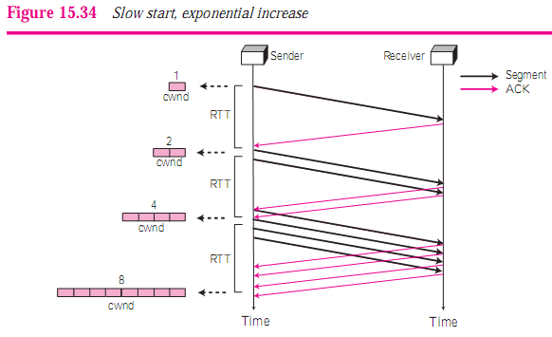
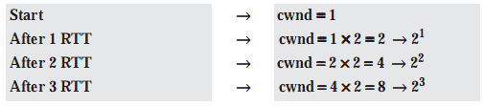

Slide 55
Congestion Avoidance: Additive Increase
To avoid congestion before it happens, one must slow down this exponential growth.
When the size of window in bytes reaches a threshold (where cwnd = i), slow start phase stops and the Additive phase begins.
Congestion avoidance phase: increases the cwnd additively instead of exponentially, until congestion is detected.

Slide 56
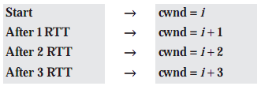
Congestion Avoidance: Additive Increase
The increase in cwnd is based on RTT, not on the number of arrived ACKs.

Slide 57
Congestion Detection: Multiplicative Decrease
If congestion occurs, the congestion window size must be decreased
The only way a sender can guess that congestion has occurred is the need to retransmit a segment
Retransmission can occur in one of two cases:
  when the RTO timer times out or
  when three duplicate ACKs are received.
In both cases, the size of the threshold is dropped to half (multiplicative decrease)

Slide 58
The Two Reactions
If a time-out occurs, there is a stronger possibility of congestion
  a segment has probably been dropped in the network
  In this case TCP reacts strongly:
    Threshold = ½(current window size)
    cwnd = 1 MSS
    It starts the slow start phase again

Slide 59
The Two Reactions
If three duplicate acks are received, there is a weaker possibility of congestion.
  Tcp has a weaker reaction:
    Threshold = ½(current window size).
    cwnd = threshold (some implementations add three segment sizes to the threshold).
    It starts the congestion avoidance phase.

Slide 60
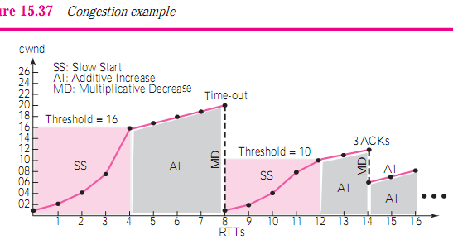

Slide 61

TCP Timers

Slide 62
TCP Timers
Retransmission Timer
  To retransmit lost segments, TCP employs one retransmission timer that handles the RTO (the waiting time for an acknowledgment of a segment).
  To calculate the retransmission time-out (RTO), we first need to calculate the round trip time (RTT).

Slide 63

RTT Calculation
Measured RTT (RTT_{M})
  Time it takes to send a segment and receive an ack for it.
Note: In TCP, only one RTT measurement can be in progress at any time
Smoothed RTT (RTT_{S})
  The RTT_{M}, is likely to change for each round trip
  Most implementations use a smoothedRTT, called RTT_{S}, which is a weighted average of RTTM and the previous RTT_{S}
  The value of α is implementation-dependent, but it is normally set to 1/8

Slide 64


RTT_{D}
Most implementations do not just use RTT_{s} ; they also calculate the RTT deviation, called RTT_{D}
The value of β is also implementation-dependent, but is usually is set to ¼
Retransmission Time-out (RTO)
  The value of RTO is based on the smoothed round-trip time and its deviation:
_{D}

Slide 65
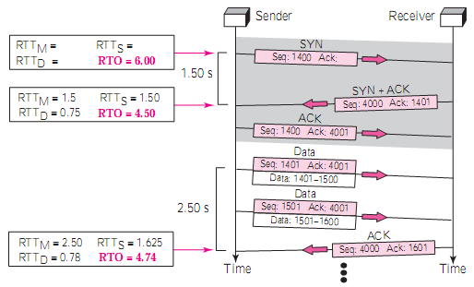
Example

Slide 66
Retransmission Ambiguity
Problem:
Suppose a segment is not ACKed before RTO and thus retransmitted
When this segment is ACKed the sender does not know if it is the original or retransmitted segment that is ACKed
Thus, TCP can’t get the measured value needed for RTT calculation

Slide 67
Retransmission Ambiguity
A
B
A
B
Original transmission
Original transmission
X
RTO
RTO
ACK
RTT
RTT
retransmission
retransmission
ACK

Slide 68
Karn’s Algorithm
Karn found a simple solution:
Don’t consider the RTT of a retransmitted segment
Reuse the backed off RTO for the next transmission
Don’t update RTT value until you get an ACK without need for retransmission
Next Figure is a continuation of the previous example. There is retransmission and Karn’s algorithm is applied. The first segment in the figure is sent, but lost. The RTO timer expires after 4.74 seconds. The segment is retransmitted and the timer is set to 9.48, twice the previous value of RTO. This time an ACK is received before the time-out. We wait until we send a new segment and receive the ACK for it before recalculating the RTO (Karn’s algorithm).

Slide 69
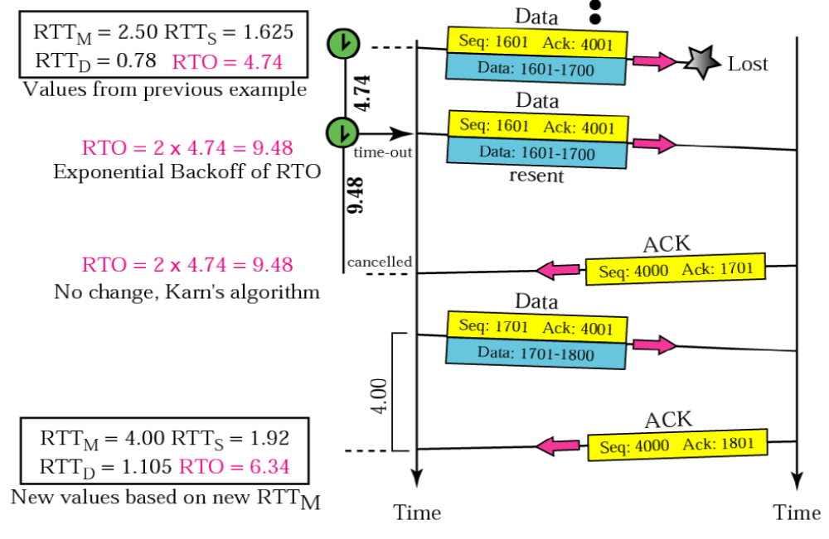
KARN’S Algorithm

